Slide 1
Telecom Churn Case Study
Sachin Sinha
Yash Khatavkar
Aswin Joseph

Slide 2
Problem Statement
Business Case:
In the telecom industry, customers are able to choose from multiple service providers and actively switch from one operator to another. In this highly competitive market, the telecommunications industry experiences an average of 15-25% annual churn rate. Given the fact that it costs 5-10 times more to acquire a new customer than to retain an existing one, customer retention has now become even more important than customer acquisition.
Problem Statement:
To reduce customer churn by identifying and predicting customers who are at high risk of churn
Objective:
There are two objective for
Predict whether a high-value customer will churn or not, in near future by building up predictive model
identify important variables that are strong predictors of churn and recommend strategies to manage customer churn. These variables may also indicate why customers choose to switch to other networks.

Slide 3






Case Study -Approach
Data Preparation & EDA
PCA
To handle multicollinearity PCA for feature selection
Identify Model
Define the high value customer > 70th percentile. Tag the churn and deal with the outliers.
Based on churn variables to be predicted through logistic regression or family of tree model
Data Cleaning - EDA
Random Forest
Identify the missing values and deal with the missing value either by dropping or imputing them
To identify if the decision tree or logistic model is better
Strategy to manage churn
Data Understanding
Load the data and understand the variables provided in the data set
Recommend Strategies to manage customer.churn based on obersation
Telecom Churn

Slide 4
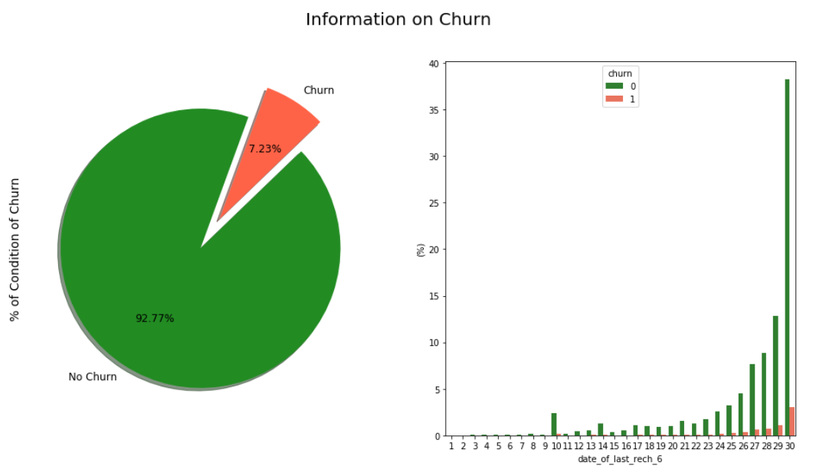
Data Understanding, Preparation & EDA
Data Understanding:
Total no of Unique customer: 99999
No of variables: 226
Object: 12
Numeric: 214
EDA:
Missing value
40 variable have more than 50% missing value
The missing values have been imputed with 0 as the variable are significant for analysis
The missing values in date column been dropped
Filter High Value customers:
No of High value customers:29906
% of High value customers: 30%
Churn:
2418 are tagged as churns out of 29906 high value customers
From the above values we can see that there are just **8.09% churn** cases.
Dataset is **highly imbalanced**, with the non-churners constituting the majority (91.91%) and the churn instances being the minority (8.09%).
Post outlier and missing value treatment non churns constitute 92.77% and churn 7.23%

Slide 5


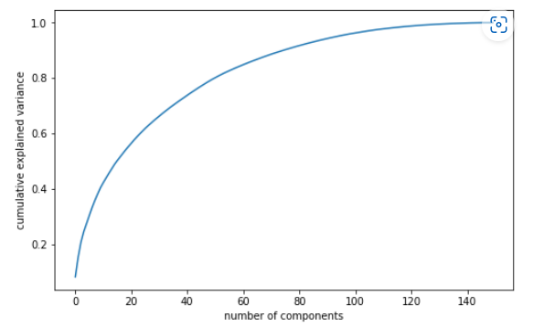
Model Building
Handling Class imbalance:
Before handling imbalance -
Considering there is significant amount of imbalance SMOTE technique is used to reduce class imbalance
After handling the imbalance –
PCA:
It can be observed that 80 components account for 90 % of the variance.
Considering large data incremental PCA is the model used
As can be seen, there is almost no link between the two components. Our data was successfully cleaned
of multicollinearity, and as a result, our models will be significantly more reliable

Slide 6
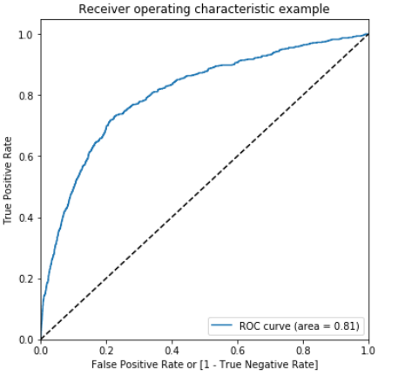
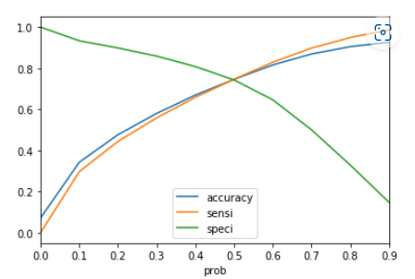
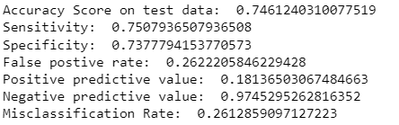

Model Building – Logistic Regression
Logistic Regression Model:
Logistic regression model has been chosen considering churn is a classification data
ROC curve:
Area under ROC curve is 0.81 which is closer to one which shows the
model is better performing model when it comes to classification
Churn with predicted y with x> 0.49:
Optimal probability threshold:
0.49 is the optimal threshold for logistic regression
Metrics of logistic regression model:

Slide 7
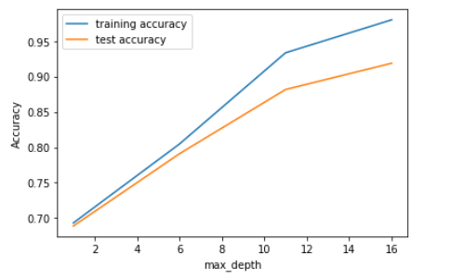
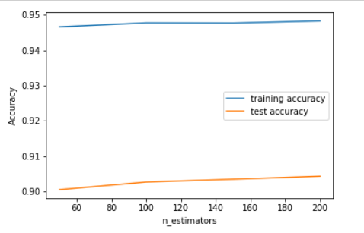
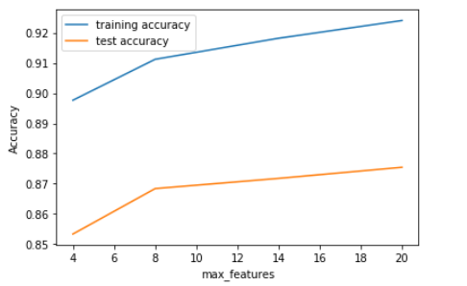
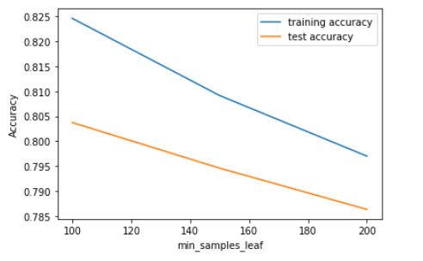
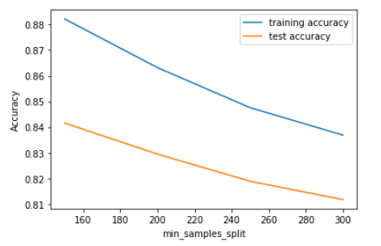
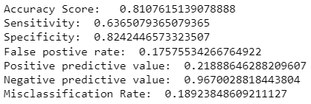
Model Building – Random Forest
Random Forest:
Hyperparameter tuning
Max_depth:
N-estimators:
Max_features:
Min sample leaf:
Min sample split:
Metrics of logistic regression model:
Metrics of Random forest model:
Conclusion : The results of the customer churn analysis showed that Logistic Regression outperformed Decision Tree. As Logistic Regression has a higher sensitivity and better specificity score, we may be able to predict prospective client attrition.

Slide 8
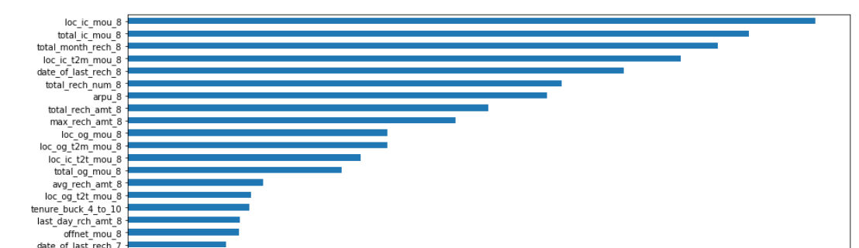
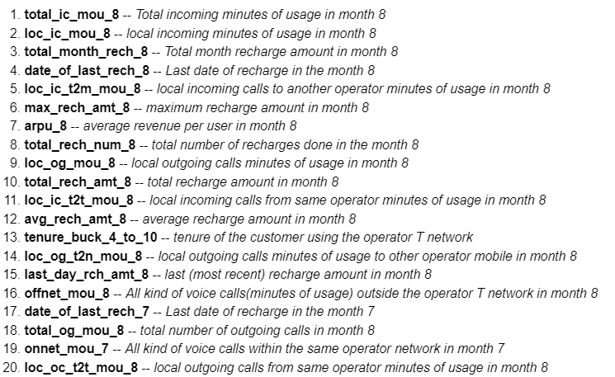
Observations and Recommendations
Top Variables:
Recommendations:
Top characteristics are those that are predominantly associated with month 8, or the action phase, as determined by our Random Forest implementation.
Providing discounts and additional service packs during phase to customers would help in better churn

Slide 9
Thank You

